Slide 1

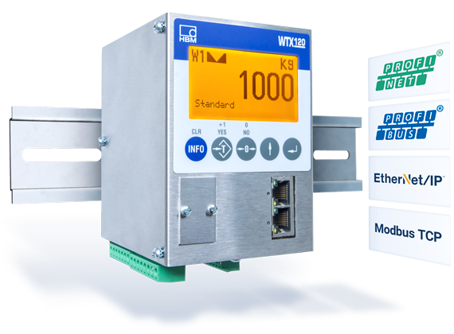
Connection via Modbus TCP in less than 30 Minutes WTX120 presented by
Notes:
Sicherstellen, dass insbesondere bei 4 und 5 keine internen Infos rausgehen!

Slide 2
Agenda
Prerequisites
Hardware
Software
Step-by-Step
Use Demo Examples
Programing own Window Using the API
Link Collection
Notes:
Evtl. erst Technologien und dann PanelX

Slide 3
Prerequisites - Hardware
HBM WTX120 weighing terminal
Supply voltage for WTX120 (12V-30V, DC)
RJ45 Cable (“LAN” Cable)
A weighing sensor, e.g. HBM PW6C
Computer with LAN-port or which is connected to the same network as the WTX
Visual Studio 2017 hardware requirements:
Min. 1.8 GHz processor (dual-core recommended)
Min. 2 GB RAM (4 GB recommended)
Around 20-50 GB hard disk space

Slide 4
Prerequisites - Software
Windows operating system, min. Win7 SP1
(for programming also macOS possible)
Min. Visual Studio (VS) 2013
.Net Version 4.5.2

Slide 5
VS Community License - Extract
“For organizations
An unlimited number of users within an organization can use Visual Studio Community for the following scenarios: in a classroom learning environment, for academic research, or for contributing to open source projects
For all other usage scenarios: In non-enterprise organizations, up to five users can use Visual Studio Community. In enterprise organizations (meaning those with >250 PCs or >$1 Million US Dollars in annual revenue)
For individuals
Any individual developer can use Visual Studio Community to create their own free or paid apps.”
From https://www.visualstudio.com/vs/community/ (02/14/2018)
After 30 days you have to log in with a Microsoft account to unlock the test version
Everyone else needs another license!

Slide 6
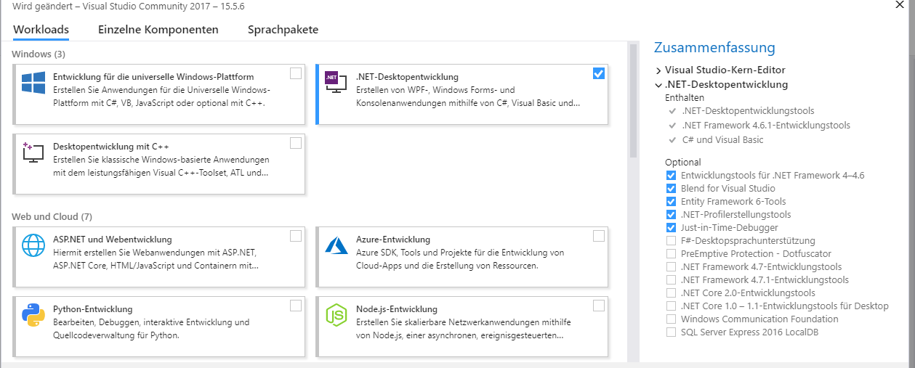
Step-by-Step: Software
You can find all required links for downloads in the Link-Collection
Install VS with .NET-Development extension or basic version and install required packages afterwards
Download ModbusTCP_WTX from GitHub
Picture: VS Required Tools and Features

Slide 7
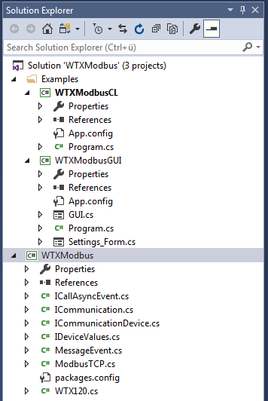
Step-by-Step: Connect WTX
Connect WTX120 with the same network as your PC (note: WTX does not support DHCP currently, only fixed IP)
Or connect directly to your PC, the IP-address in WTX must be the same, where the subnet-mask is 255, and different, where it is 0
Open WTXModbus.sln in the main folder of the Modbus download
Project overview: two examples, a command
line application (CL) and a graphic application
(GUI), and the API WTXModbus
You need internet access during the first build,
because WTXModbus downloads 2 NuGet-
packages one-time
Picture: Project Overview

Slide 8
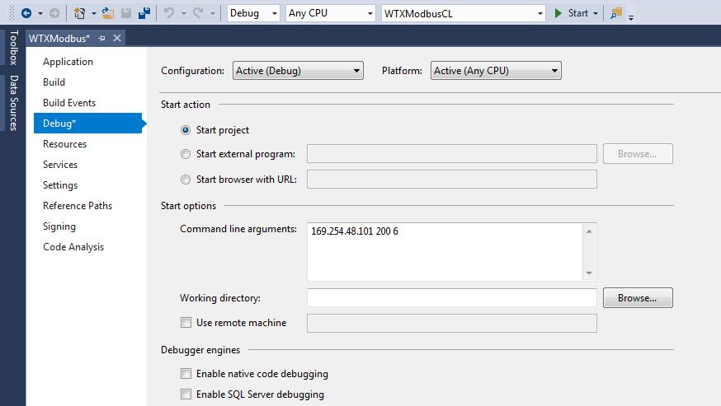
Step-by-Step: Demo Example Application
Start a demo example:
Note: if you choose WTXModbusCL, you have to set the IP in the VS project properties menu as an argument
Choose command line or graphic version
Use the IP of your WTX
Picture: WTXModbusCL Project Menu (Project-> WTXModbusCL Properties… -> Debug)
If a failure occurs during build, probably you have not installed all required VS packages

Slide 9
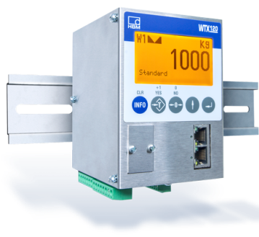
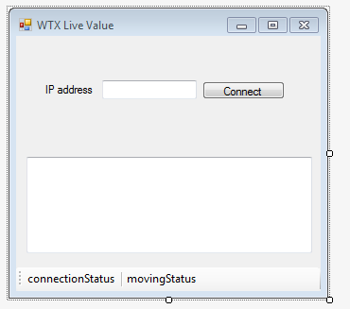
Step-by-Step: Use the API – Overview
Real World
Connect()
API
Modbus_TCP_obj
WTX_obj
has
GrossValue
NettValue
…
IP_Address
isConnected
Async_Call(Opcode, CallbackMethod)
API
Own User Interface
CallbackMethod()
Async_Call() “updates” the values in WTX_obj via Modbus_TCP_obj from your WTX device
Timer in your window calls periodically Async_Call()
CallbackMethod() is executed as soon as the values are up-to-date
Picture: Example Window User Interface

Slide 10
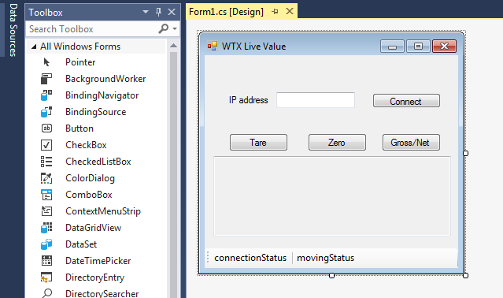
Step-by-Step: Make your own App
Add a new Windows Forms App project to the Solution
Use the VS Toolbox to create a display window (drag & drop)
It is recommended to use a timer from the toolbox to refresh the values
Double-click on buttons or timer to create empty methods in code
Use F7 to switch to the programming view
Add using Hbm.Devices.WTXModbus
Create ModbusTCP and WTX120 objects
Call Connect() on Modbus object
Picture: VS Toolbox with Example Window
// Code Example:
Using Hbm.Devices.WTXModbus
…
ModbusTCP Modbus_TCP_obj;
WTX120 WTX_obj;
…
// ipAddress is a string like “199.199.21.1”
Modbus_TCP_obj = new ModbusTCP(ipAddress);
WTX_obj = new WTX120("WTX120_1", Modbus_TCP_obj);
Modbus_TCP_obj.Connect();

Slide 11
Step-by-Step: Make your own App
Start the timer
Call WTX_obj.Async_Call(Op_Code, CallbackMethod) at each tick of the timer
Async_Call() updates the values in the WTX class
from the WTX device
Op_Code 0x00 is reading values
CallbackMethod() is executed when the values are updated
// Code Example:
//start timer
timer1.Enabled = true;
timer1.Interval = 200;
timer1.Start();
…
// at each timer tick
private void timer1_Tick(object sender, EventArgs e)
{
WTX_obj.Async_Call(0x00, CallbackMethod);
}

Slide 12
Step-by-Step: Callback Method
There you write, what you want to do each period, e.g. showing a value
Access to values: e.g. WTX_obj.GrossValue
You have access to all values mentioned in the WTX120 manual, chapter PLC link
To show the correct gross value, use WTX_obj.decimals to get the number of decimal places
// Code Example
public void CallbackMethod(IDeviceValues Device_Values)
{
textBox2.Text = "Gross: " + convertInt2Value(WTX_obj.GrossValue);
}
private String convertInt2Value(int value)
{
double temp = (double)value;
if (WTX_obj.decimals>0) temp /= (double) (WTX_obj.decimals * 10);
String unit;
switch (WTX_obj.unit)
{
case 0: unit = "kg";
break;
case 1: unit = "g";
break;
// …
}
return temp.ToString() + unit;
}

Slide 13
Step-by-Step: Add Control Buttons
Add a button with the VS Toolbox
Double click on it opens the method for programing
Check whether WTX is connected
Call WTX_obj.Async_Call(Op_Code, Write_CallbackMethod)
Do in Write_CallbackMethod() whatever you want after write is executed (nothing is also possible)
Op_Code | Meaning
0x1 | Taring
0x2 | Switch Gross / NET
0x40 | Zeroing
… | …
// Code Example
// Button Tare
private void button2_Click(object sender, EventArgs e)
{
if (Modbus_TCP_obj.is_connected)
{
WTX_obj.Async_Call(0x1, Write_CallbackMethod);
}
}
Picture: Example Operation Codes for Async_Call(). For more see WTX120 manual.

Slide 14
Step-by-Step: Outlook
For more details or functions have a look at the examples GUI and CL or at the WTX120 manual
GUI has everything implemented, which is possible to do via Modbus

Slide 15
Link Collection
WTX120 Website:
https://www.hbm.com/en/6304/wtx120-industrial-and-legal-for-trade-weighing-terminal/
WTX120 Manual:
https://www.hbm.com/fileadmin/mediapool/hbmdoc/technical/a4500.pdf
ModbusTCP API on Github: (unofficial, later …/HBM)
https://github.com/leistner/ModbusTCP_WTX
Microsoft Visual Studio:
https://www.visualstudio.com/vs/

